Slide 1
Tiniest Storyteller
Small and Efficient Language Models (SLM)
Arian Urdu, 24.04.2024

Slide 2


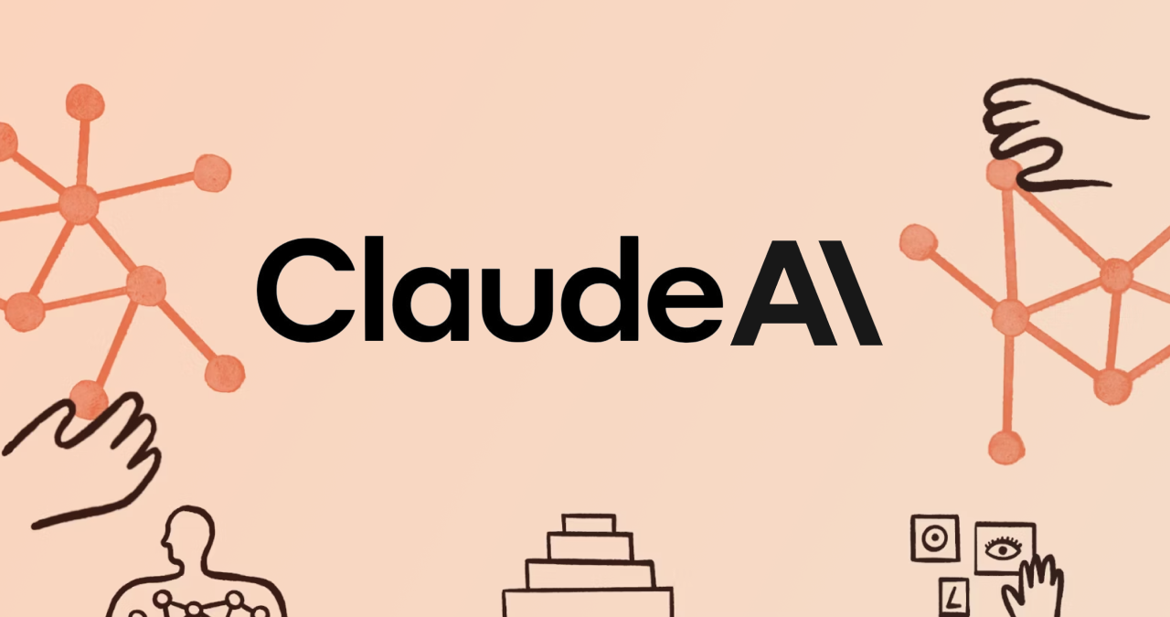
Opus (2 T)
Chat-GPT 4 (1.7 T)
-> Models require a huge amount of data / training

Slide 3
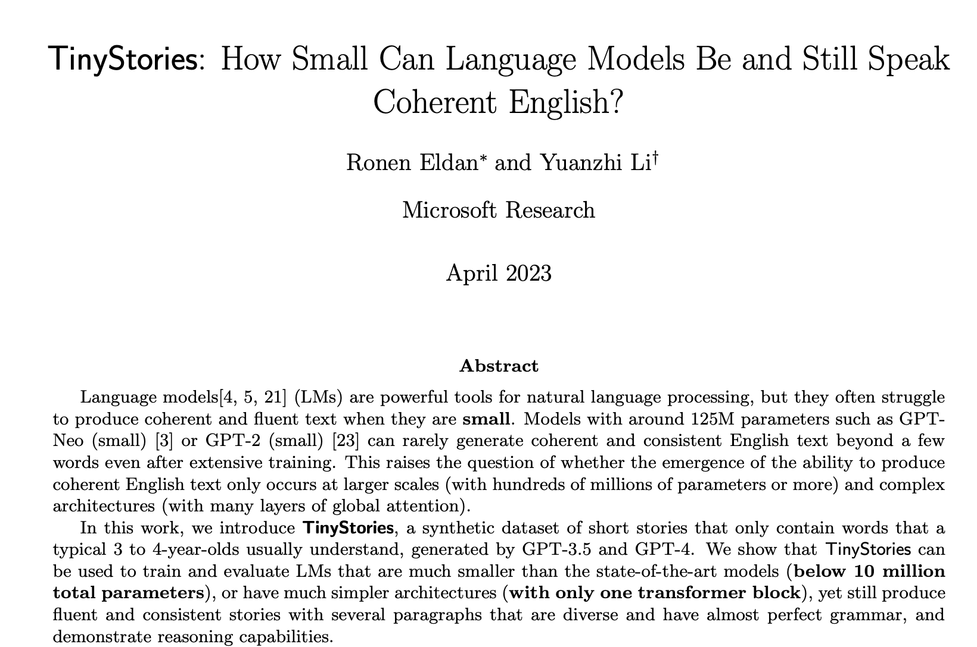
“Instead of training on just raw web data, why don’t you look for data which is of extremely high quality?”

Slide 4
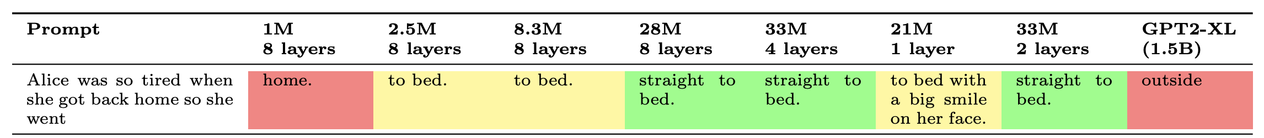
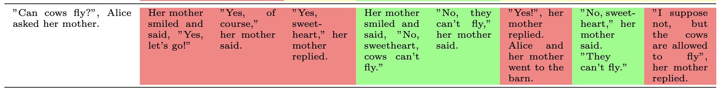
Even Small Models can be just as good
if not even better

Slide 5
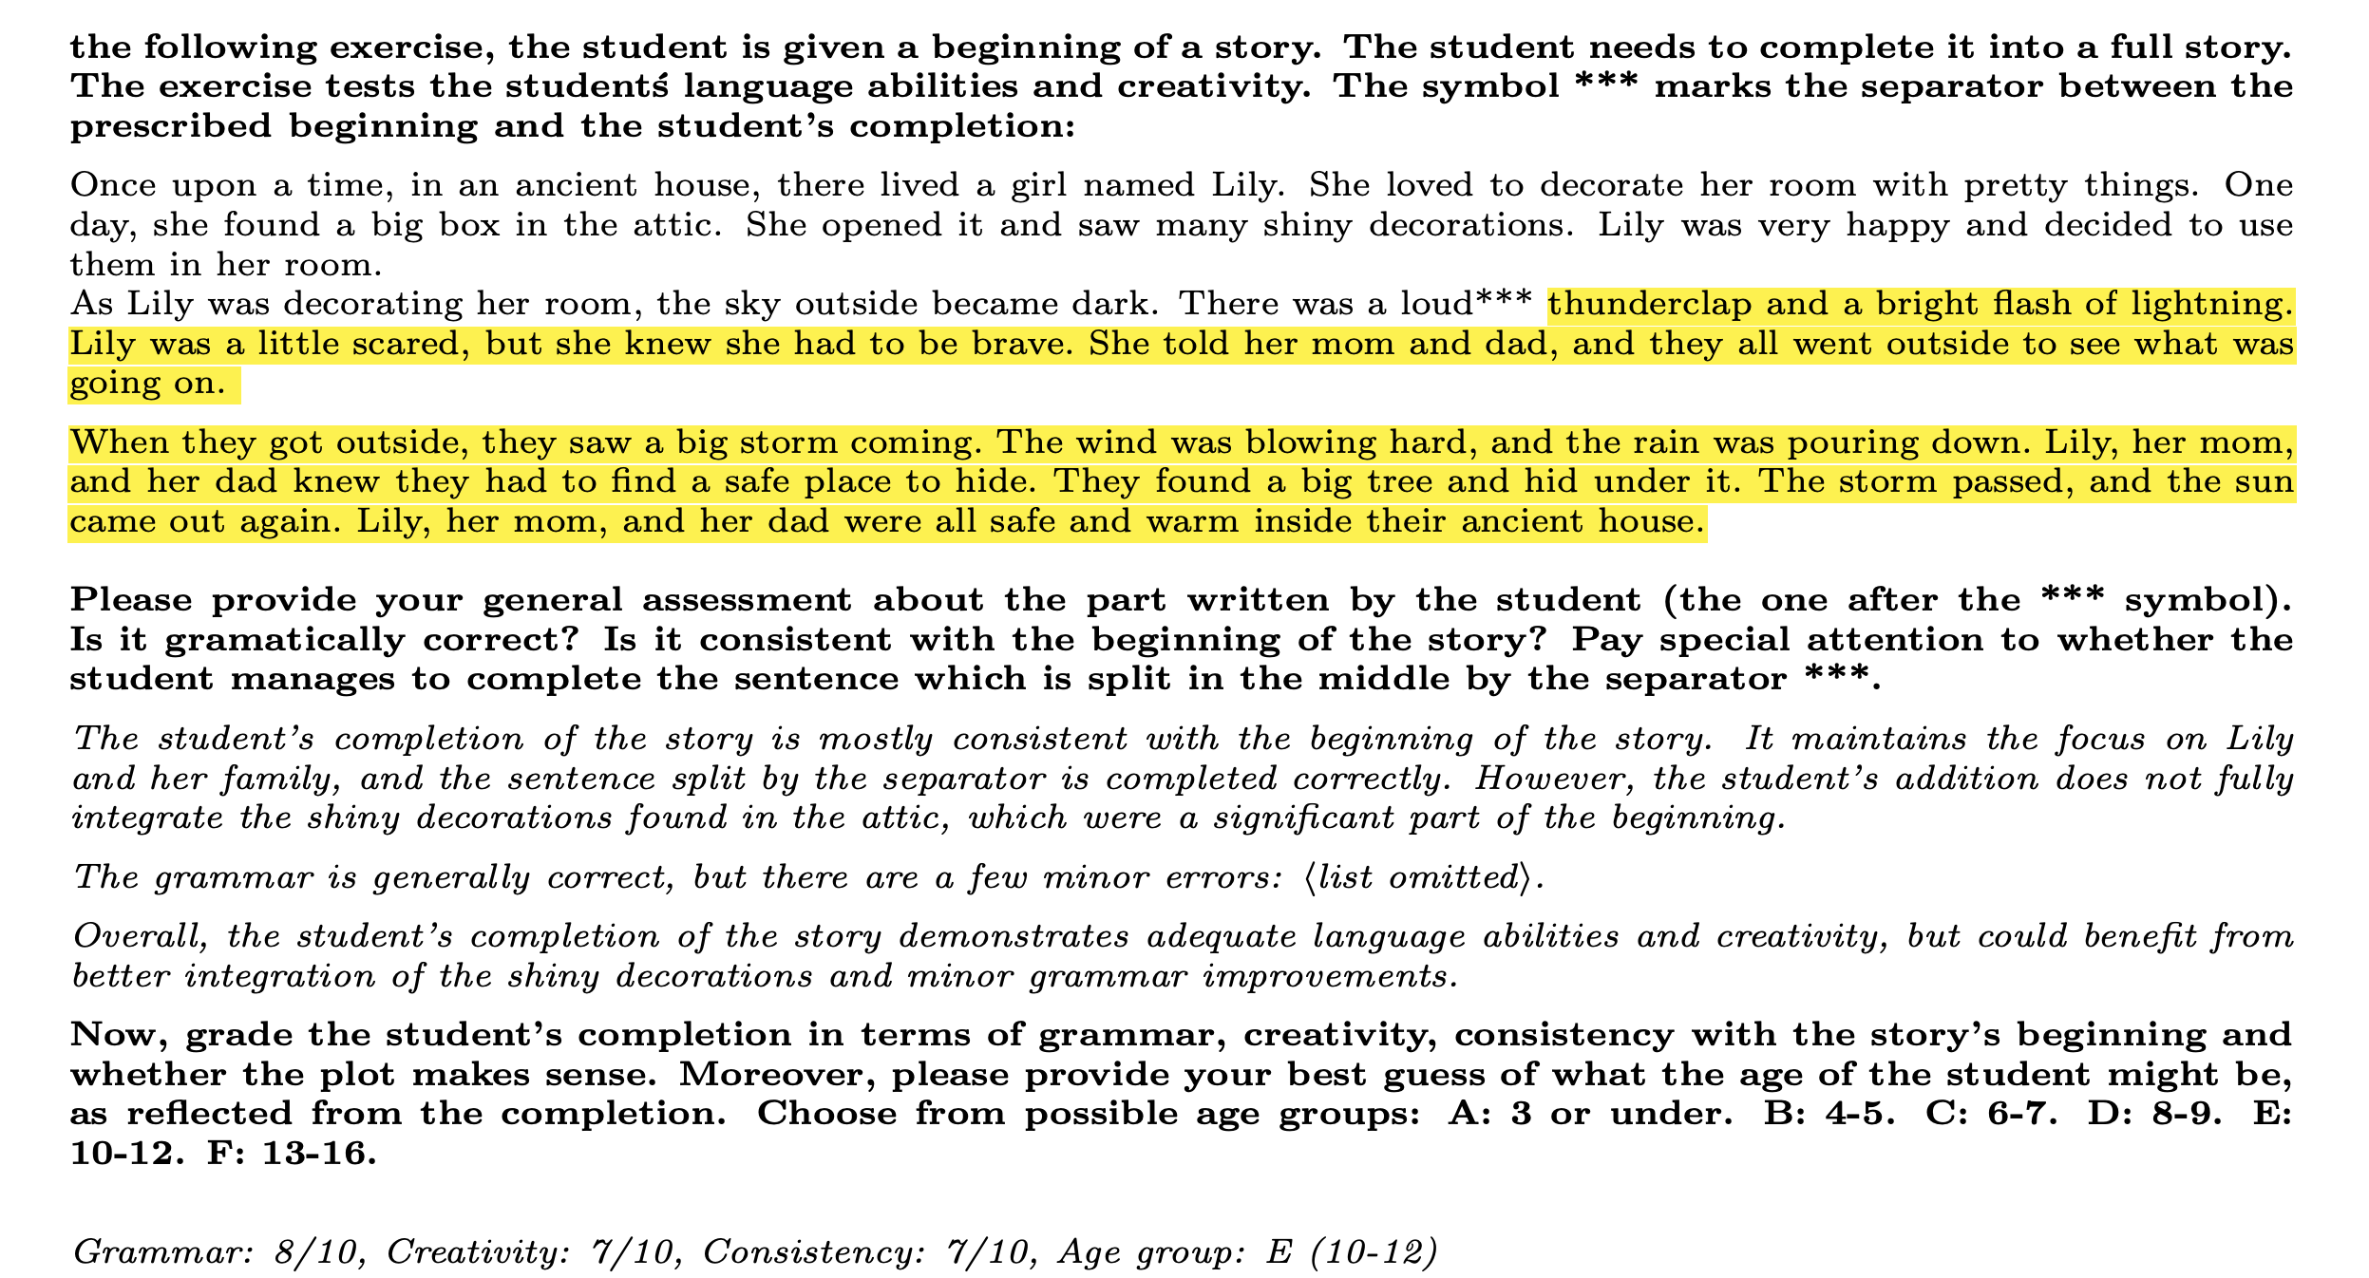
GPT-Eval:
A framework for evaluating models trained on TinyStories

Slide 6
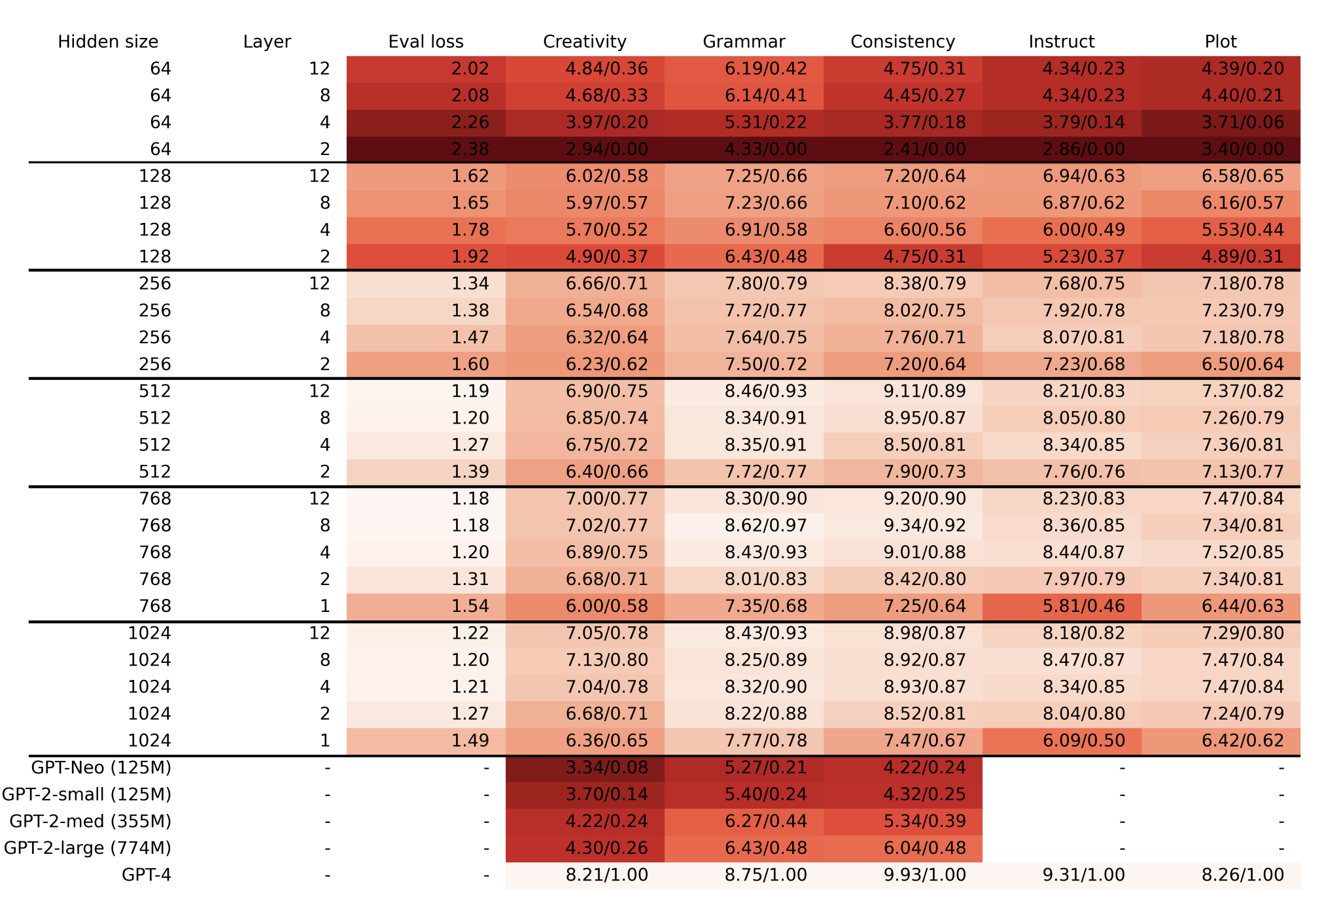
Baseline

Slide 7



Data
Model
Eval
Tinystories Dataset
Tinystories1M Model
GPT-Eval
(ChatGPT 4)

Slide 8
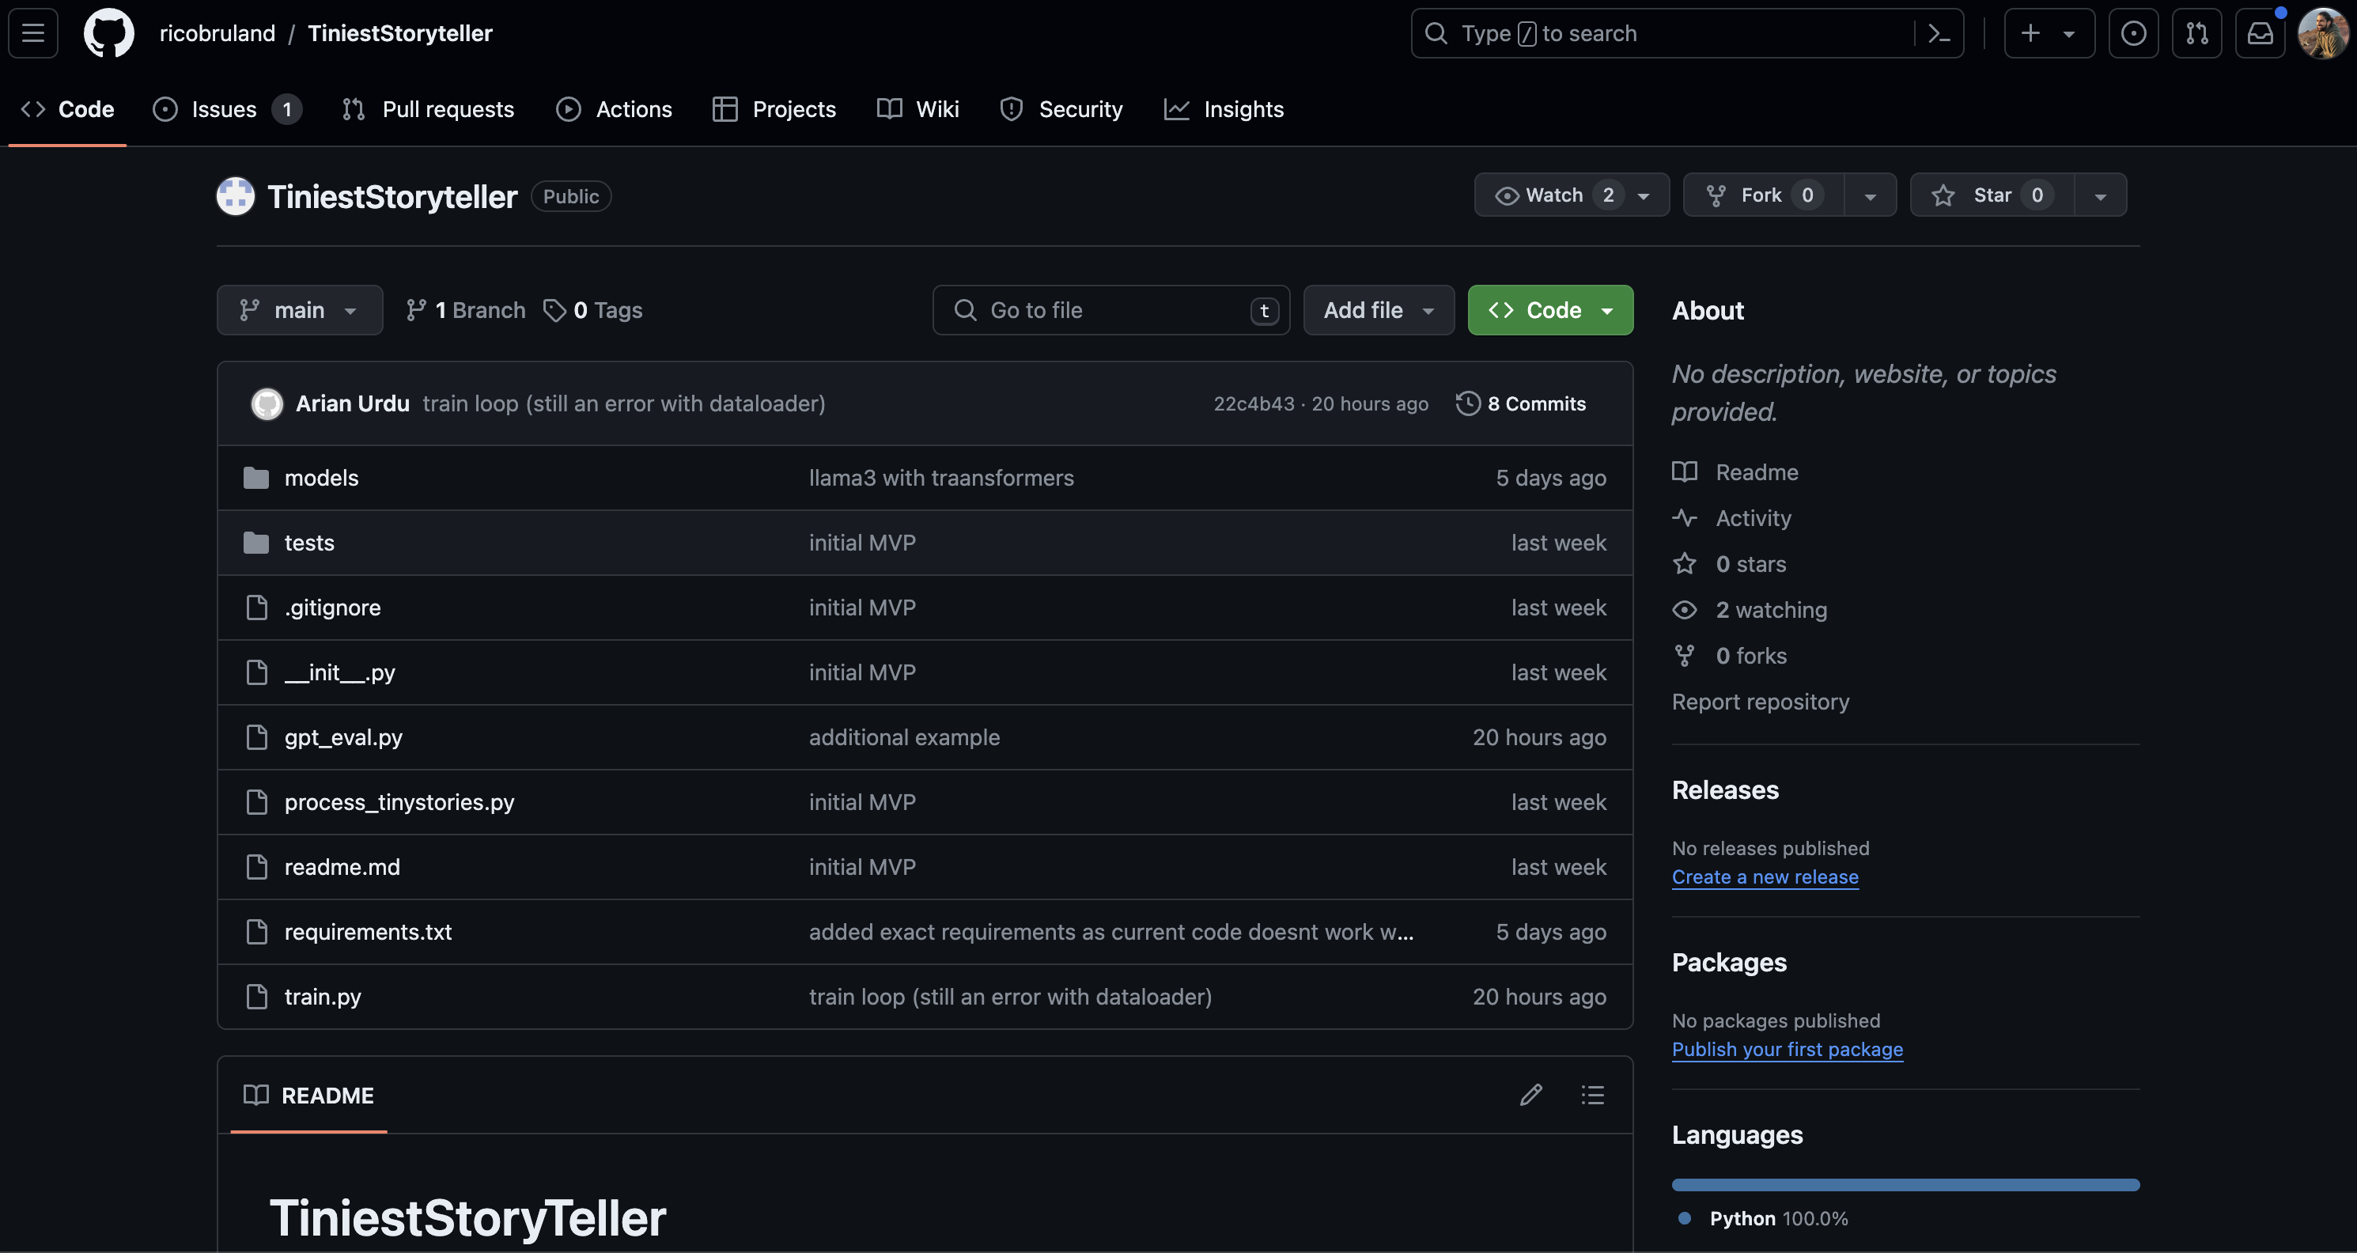
How does this look in code?

Slide 9
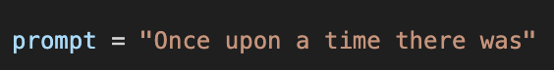
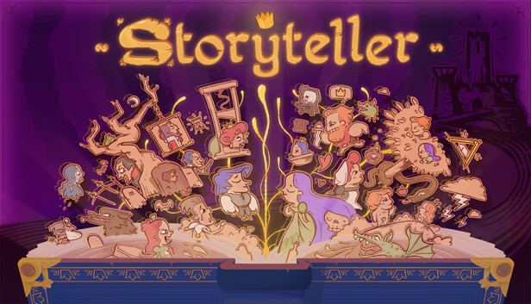

Minimum Viable Product (MVP)
Model: TinyStories-1M
GPT-Eval: Llama3-70B

Slide 10
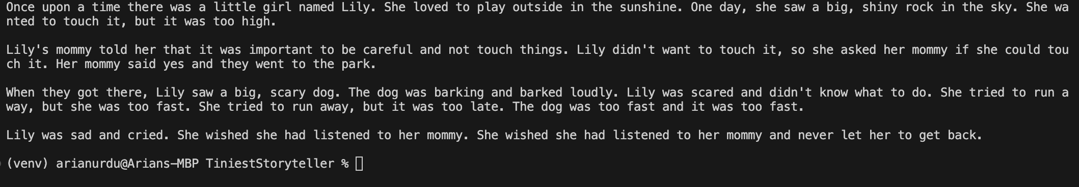
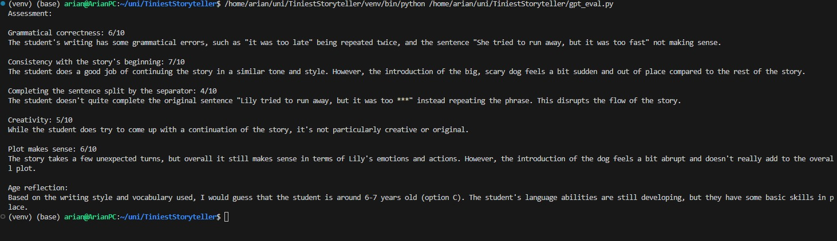
MVP Example:

Slide 11
Data
Model
Eval
Tinystories Dataset
Tinystories1M Model
GPT-Eval
(ChatGPT 4)
+ Smaller Model Llama-70B

Slide 12
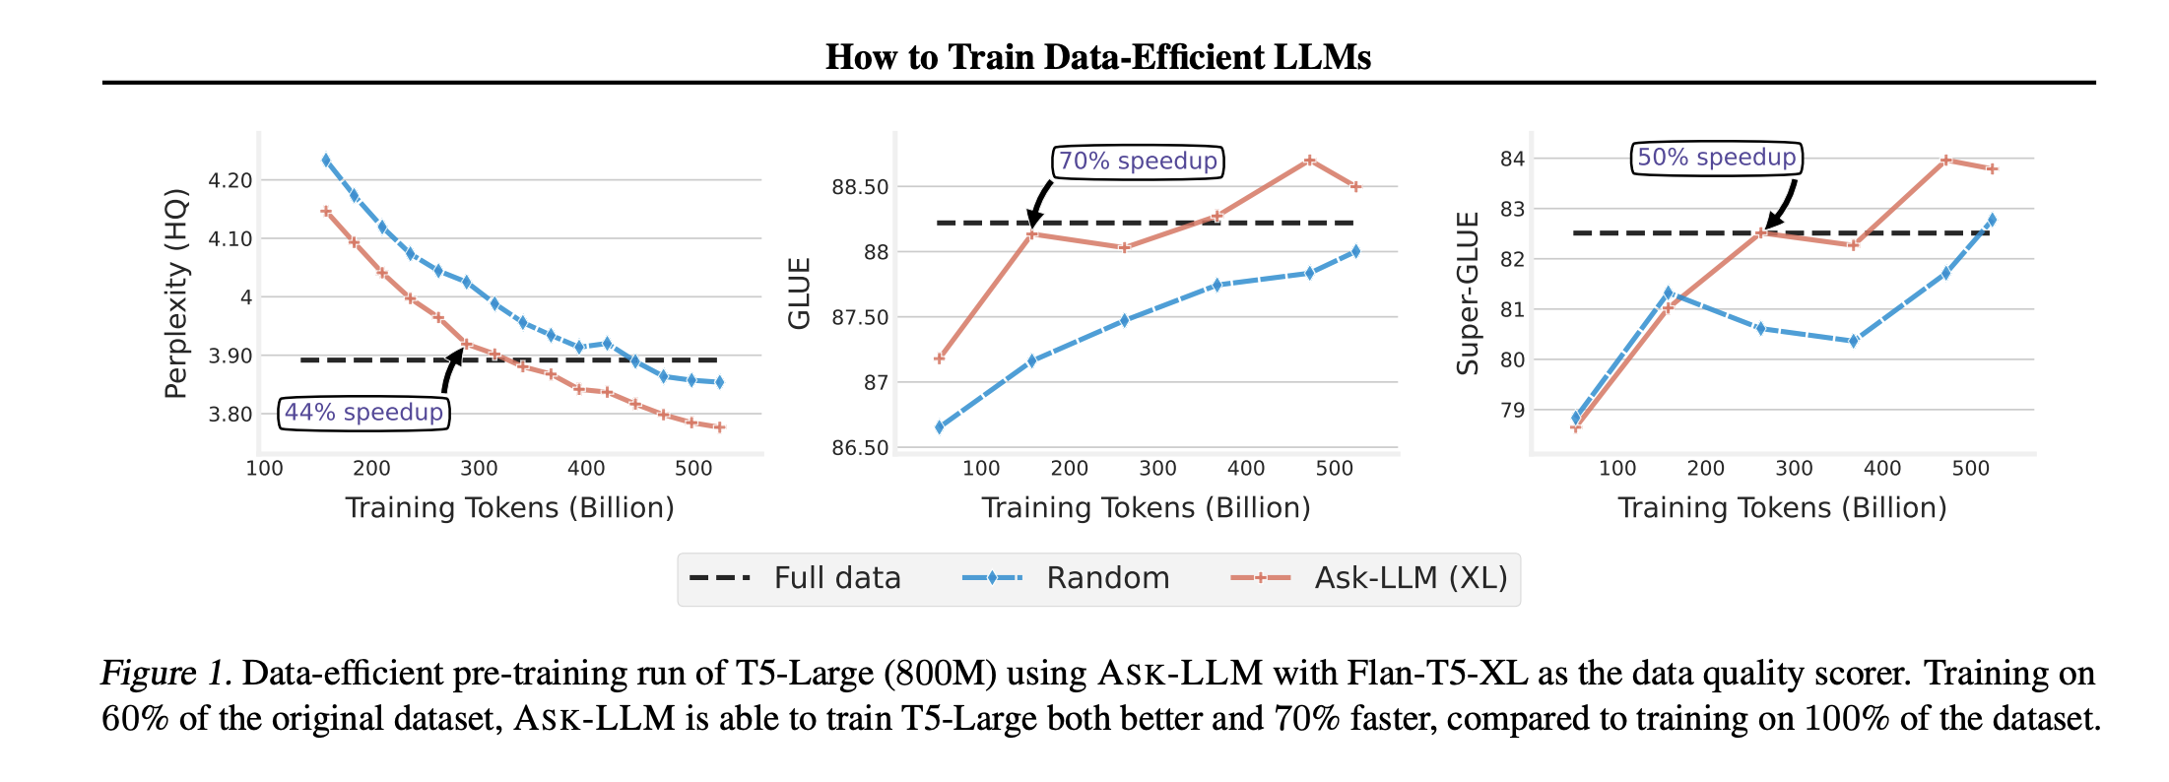
Training Efficiently

Slide 13
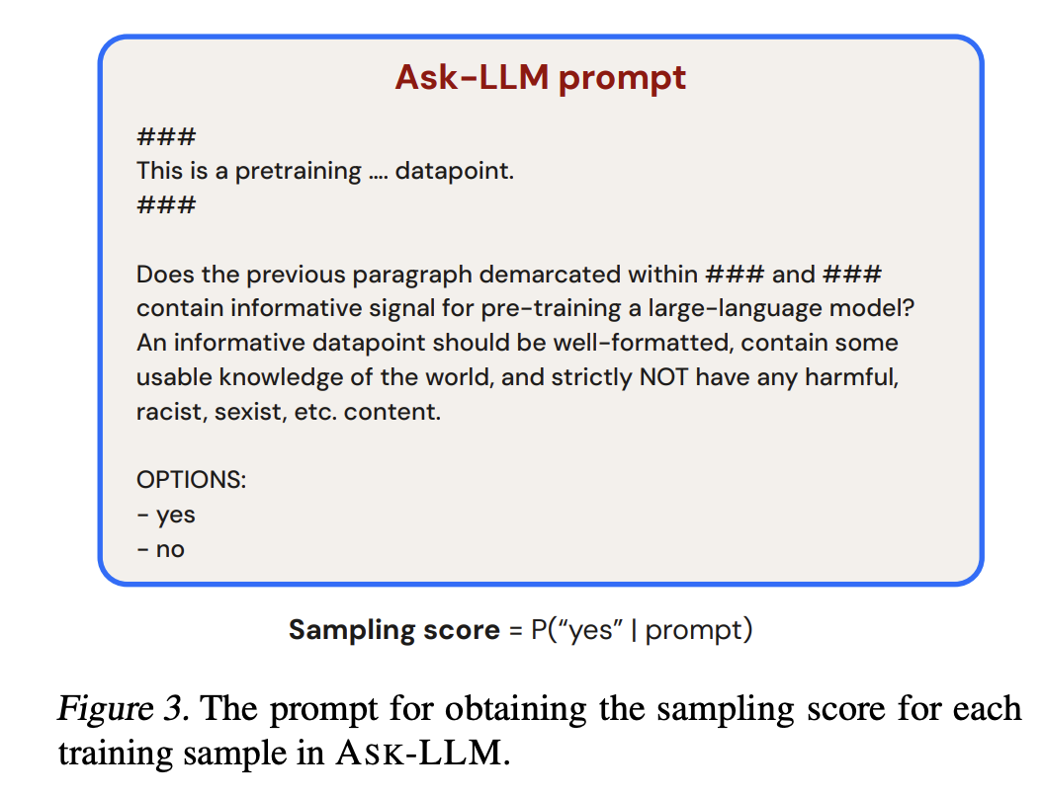

Slide 14
Data
Model
Eval
Tinystories Dataset
Tinystories-1M Model
GPT-Eval
(ChatGPT 4)
+ Filter Data using an LLM
+ Own model based on Transformer Architecture
+ Smaller Model Llama-70B

Slide 15
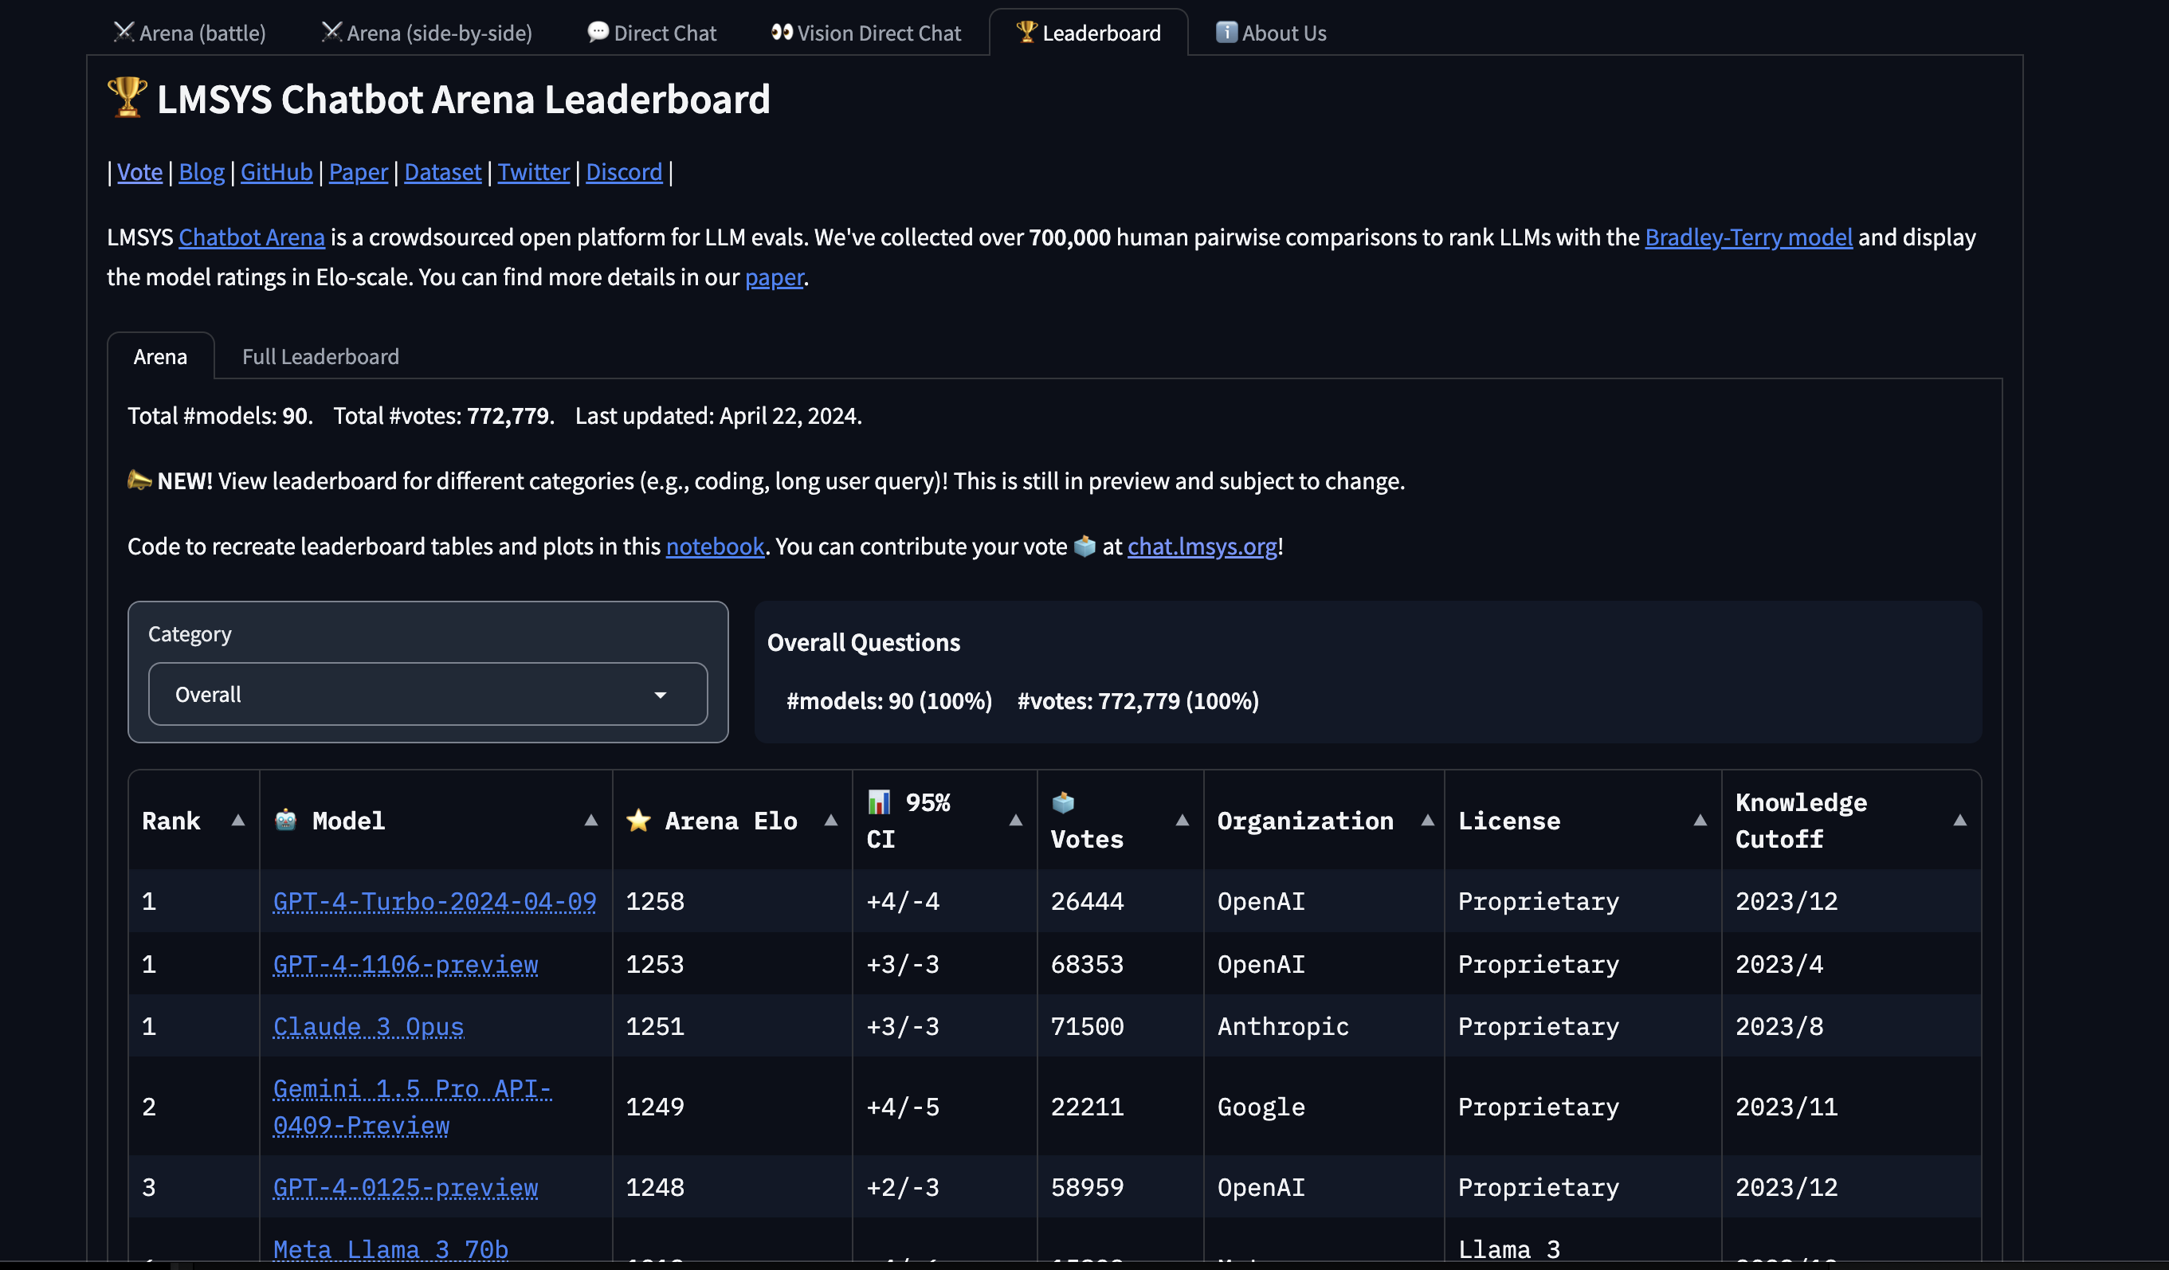
LLM Arena ⚔️

Slide 16
Data
Model
Eval
Tinystories Dataset
Tinystories-1M Model
GPT-Eval
(ChatGPT 4)
+ Filter Data using an LLM
+ Own model based on Transformer Architecture
+ Smaller Model Llama-70B
(More…?)
(MAMBA…?)
(LLM Arena ⚔️…?)

Slide 17

Goals
1. Get clear baseline
2. Filter training data with LLM
3. Implement Training Loop for own Transformer Model

